Slide 1
American Industrial Revolution
Period from 1820-1870

Slide 2
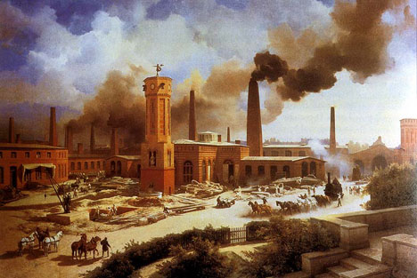
Industrial Revolution
The Industrial Revolution itself refers to a change from hand and home production to machine and factory. The first industrial revolution was important for the inventions of spinning and weaving machines operated by water power which was eventually replaced by steam. This helped increase America’s growth. However, the industrial revolution truly changed American society and economy into a modern urban-industrial state

Slide 3
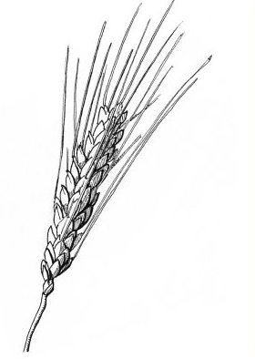

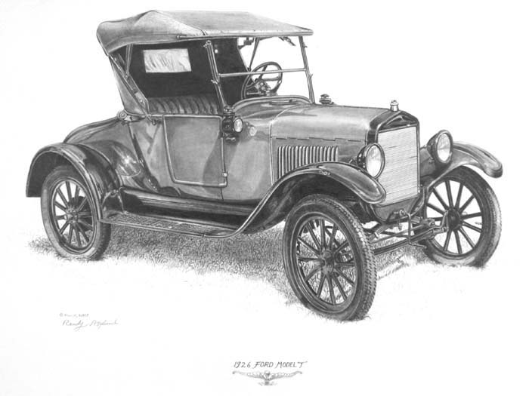
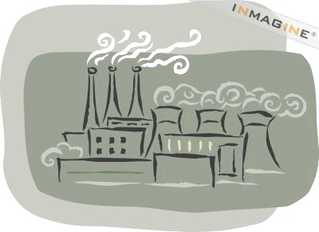
Changes in daily life
Major changes in agriculture, manufacturing, mining, and transport had a profound effect on almost every aspect of daily life.

Slide 4
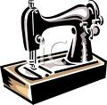
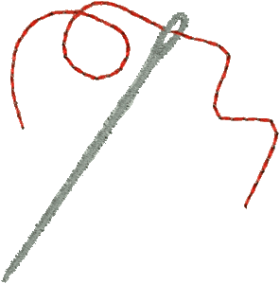
Change from home manufacturing to large scale factory production
Increase use of machines and science
Mass production ( a lot of things fast – like at the Triangle factory)

Slide 5
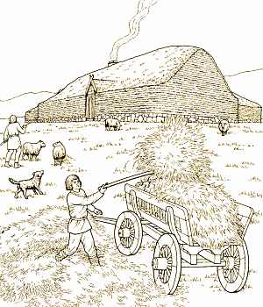
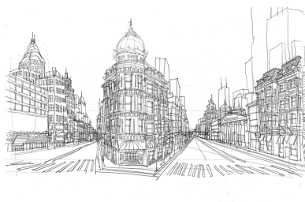
Change from Rural to Urban
Agriculture to Industry
A huge movement of people from the country to big cities
Working on farms/crops to factory work

Slide 6
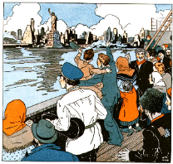
Immigration
People coming from other countries looking for a better life

Slide 7
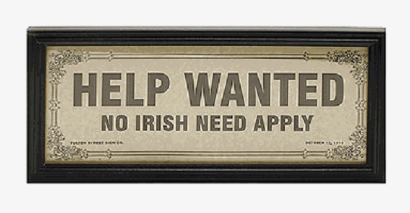
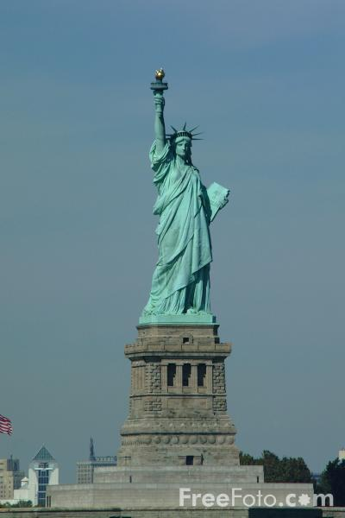
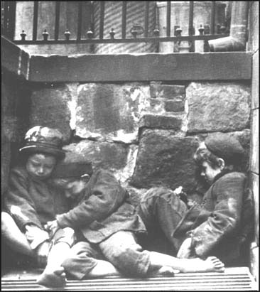
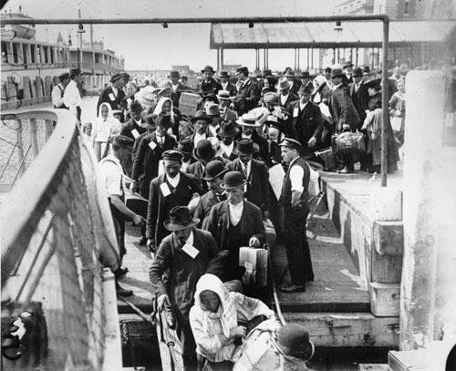
Immigration
in the 1900s

Slide 8
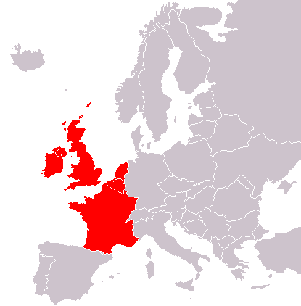
“Old Immigration”
When the 13 colonies were established, most immigrants to America were from England.
England
Ireland
France
Between 1840-1850, 1.5 million immigrants came to America. Nearly ½ were from Ireland due to the potato famine of that country. Most settled in New York City or Boston

Slide 9
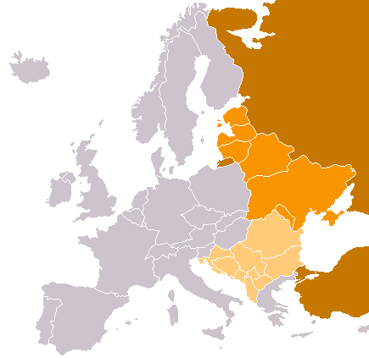
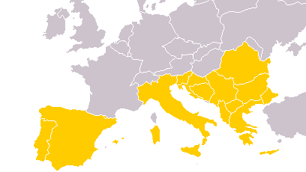
“New Immigration”
By 1920, most immigrants coming to the United States were from southern and eastern Europe
Russia
Poland
Most immigrants came from Italy, Poland or Hungary and many were Jews
Italy
Greece

Slide 10
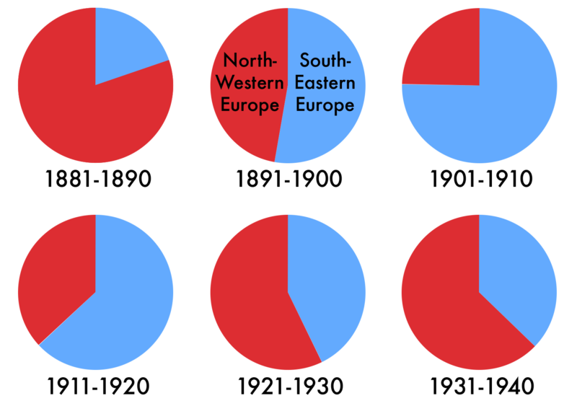
New Immigration

Slide 11
Push – Pull Factors
Push Factors: problems that cause people to move: famine, war, oppression, poverty,…
Pull Factors: attractions that draw immigrants to the U.S.: rights, jobs, opportunity,… America Letters: personal communications from friends and relatives that had already immigrated to America; land of milk and honey where the streets are paved in gold- these letters persuaded many to come to America for the AMERICAN DREAM

Slide 12
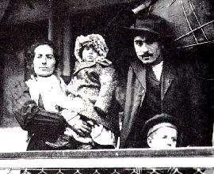
Europeans poured into the U.S. in the late 1800’s & early 1900’s
1880-1920: 25 million immigrated to the U.S.
(1/2 as many people already living in the U.S.!)

Slide 13
How did they get here?
* Passage to the United States often cost a life’s savings. Because of this cost, entire families would often save enough money to send just one or two family members to America, hoping that eventually these members could afford to bring over the rest of the family.

Slide 14
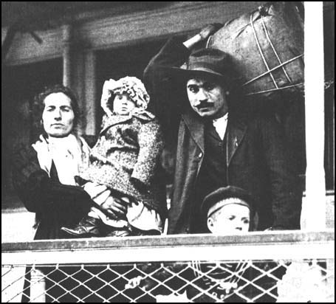
On the Boat
*The crowded steerage deck usually contained a diverse group of people. Many were poor farmers whose fathers’ or grandfathers’ land had been divided so often that the plots were no longer large enough to support even single families.

Slide 15
Travel Dangers
As for conditions below decks, an agent for the United States Immigration Commission described them as follows: “During the twelve days in the steerage I lived in…surroundings that offended every sense. Only a fresh breeze from the sea overcame the sickening odors. Everything was dirty, sticky, and disagreeable to the touch.” In such conditions, disease and even death were not uncommon.

Slide 16
A Land of Hope
The Statue of Liberty in New York Harbor was the symbol of America to many immigrants looking for a new life
“Give me your tired, your poor, your huddled masses yearning to breathe free, the wretched refuse of your teaming shore. Send these, the homeless, the tempest-tost to me, I lift my lamp beside the golden door.”
-- Statue of Liberty

Slide 17
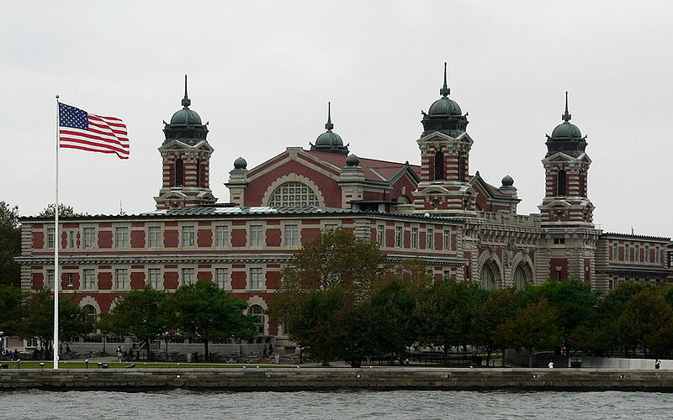
Ellis Island
Immigrants coming into New York were stopped at Ellis Island
Incoming immigrants were given a physical to check for diseases and their criminal record was checked

Slide 18
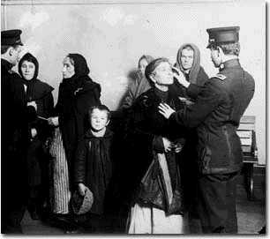
Inspection
*The immigration inspection process was a humiliating and dehumanizing experience for many. Newly arrived immigrants were given medical inspections and asked 32 background questions. Immigrants with contagious diseases were shipped back.

Slide 19
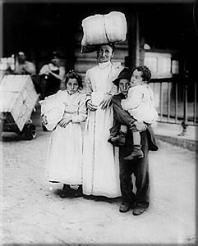
With the huge numbers of immigrants, inspectors had just 2 minutes to complete the process and many immigrants had their last names changed by the inspectors because they didn’t have the time or patience to struggle with the foreign spellings.

Slide 20
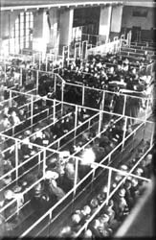
Waiting
*Long lines of immigrants were tagged according to what language they spoke and marked with chalk according to the medical ailments they suspected of having and they waited for the inspectors to decide their fate.

Slide 21
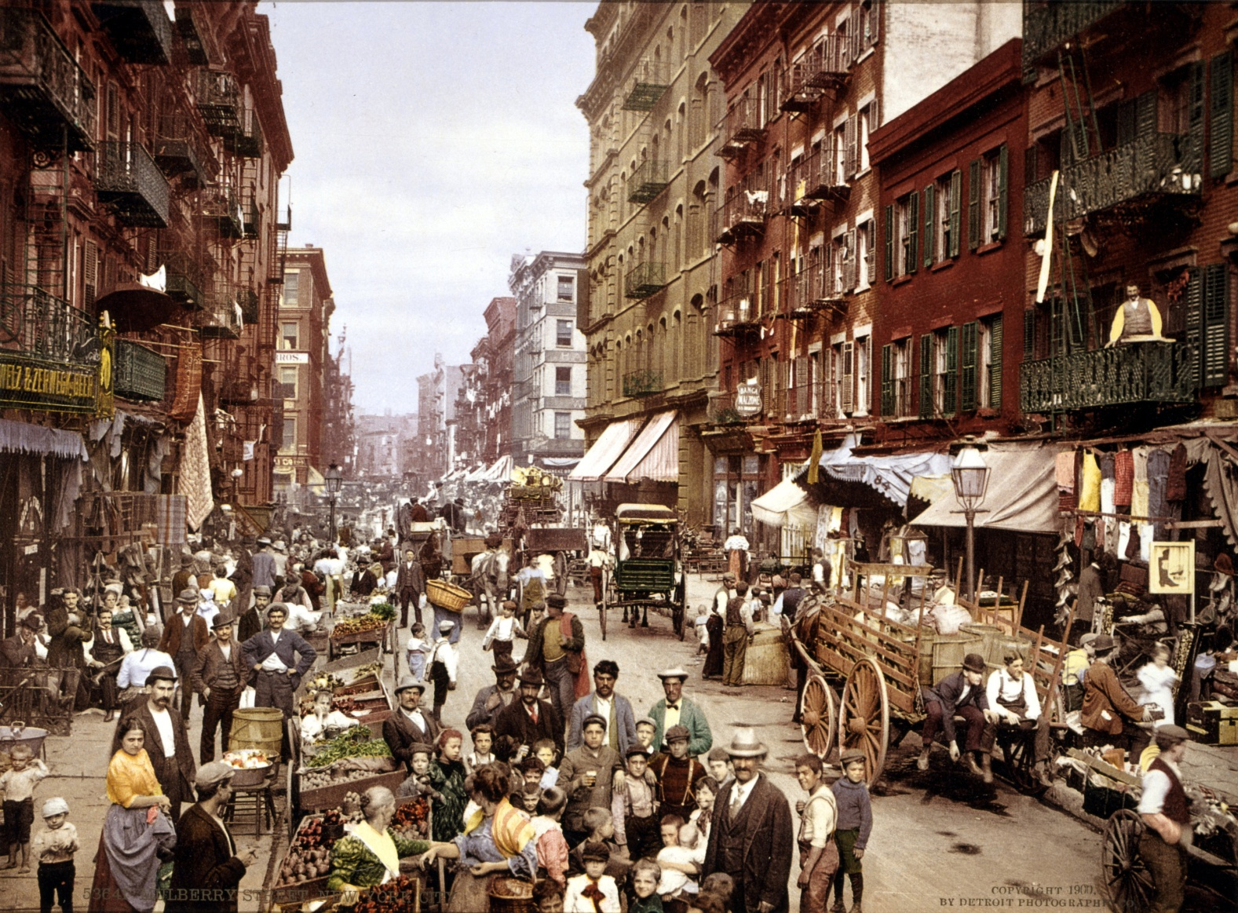
Ethnic Cities – Little Italy
By the late 1800s, immigrants made up a great portion of the country’s largest cities, including New York City, Chicago and Boston
Little Italy, New York City, circa 1901

Slide 22
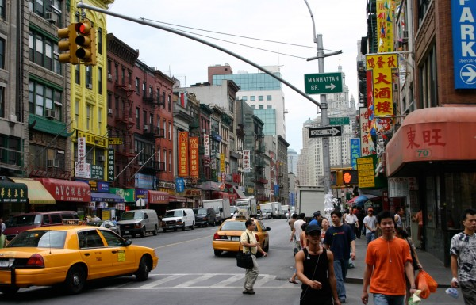
Ethnic Cities - Chinatown
Immigrants lived in their own separate neighborhoods – like Little Italy or Chinatown – and kept many of their former traditions.
Chinatown, New York City

Slide 23
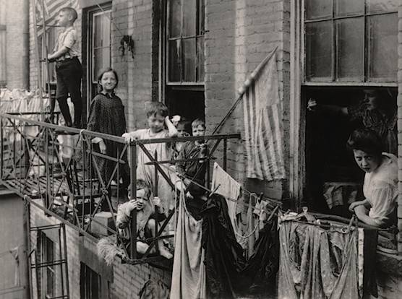
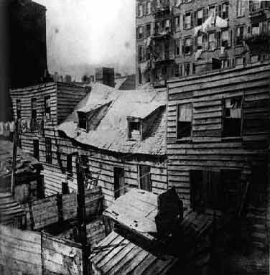
Tenement dwellings
Immigration led to a massive increase in the number of slums in U.S. cities.
Tenements – cheaply built apartment buildings – were often overcrowded and lacked many necessities.

Slide 24
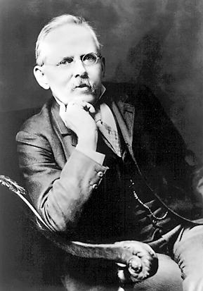
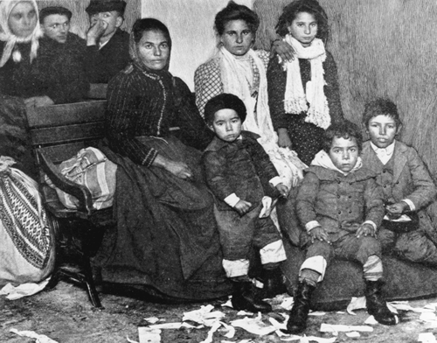
Jacob Riis
How the Other Half Lives
Jacob Riis was a journalist whose books gave a vivid account of the life for ethnic groups of New York City living in this tenement slums

Slide 25
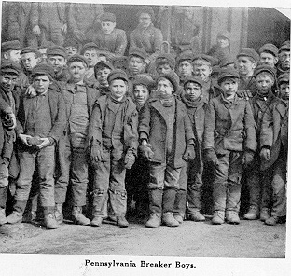
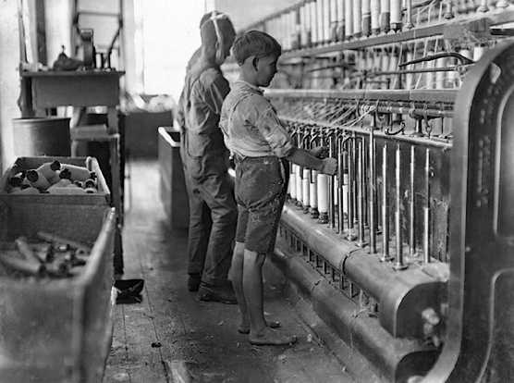
Child Labor
Immigrant children were put to work in sweatshops – businesses with harsh working conditions
Businesses wanted to hire children because they were a cheap source of labor.

Slide 26
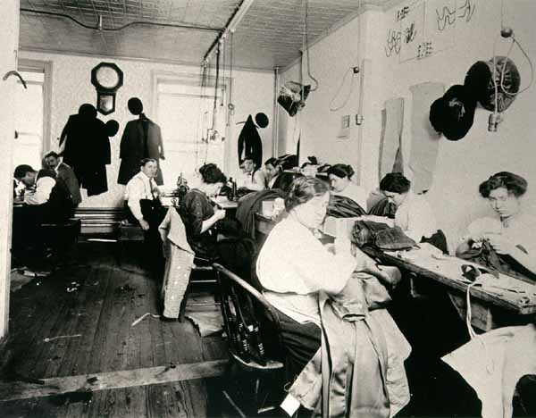
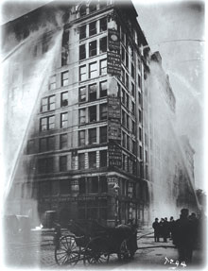
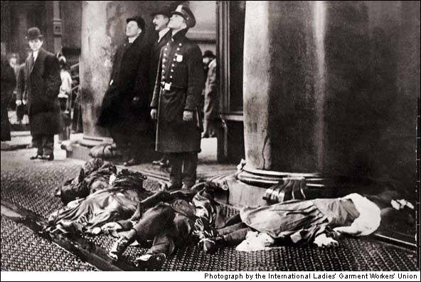
                Triangle Shirtwaist Factory
The Triangle Shirtwaist Factory fire in New York City in 1911 was the largest industrial disaster in the history of New York City
When a fire broke out in the factory, workers were locked in and could not get out.

Slide 27
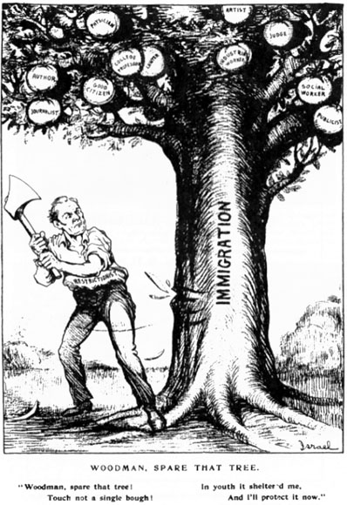
The Rise of Nativism
The flood of immigrants into the U.S. worried many Americans who felt their way of life could be changed.
Nativism is an extreme dislike for foreigners by native-born people and a desire to limit immigration.

Slide 28
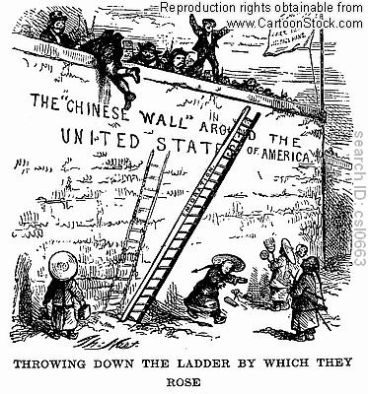
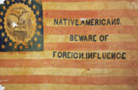
The Rise of Nativism
Workers blamed immigrants for low wages or shortages of employment. A resentment of foreigners crept into America’s attitudes.
New immigrants were easy scapegoats for the fear of social change that many experienced due to the rapid changes based on the Industrial Revolution.

Slide 29
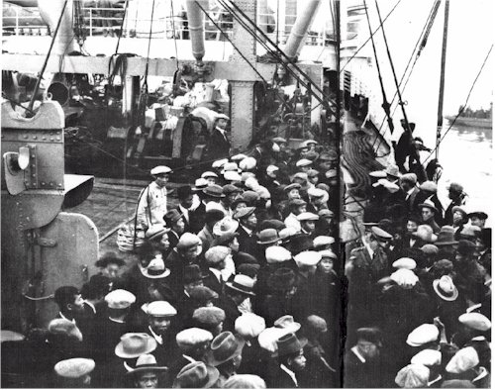
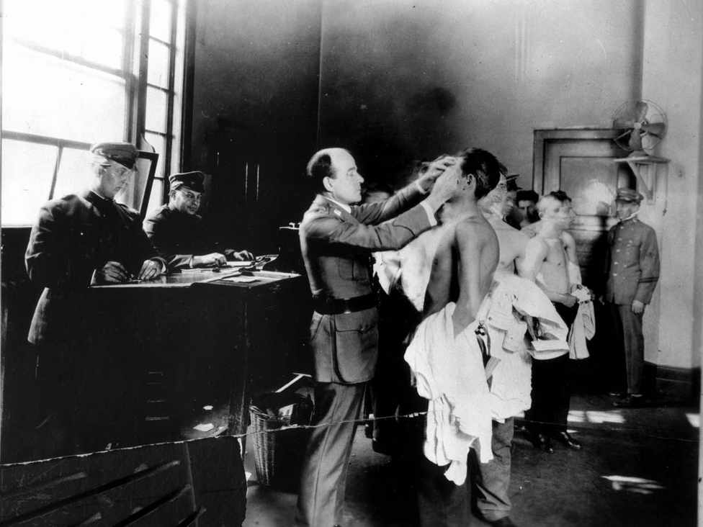
Asian Immigration
During the late 1800s, the west coast (California) saw a boom in the amount of immigrants coming from Asia.
Most Chinese immigrants came to America because over-crowding in China led to high unemployment, poverty and famine.

Slide 30
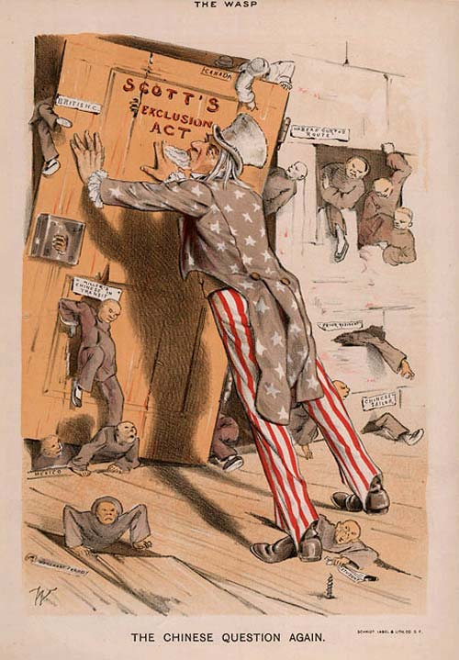
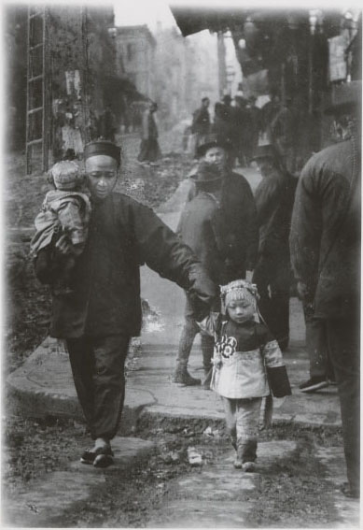
Chinese Exclusion Act
The Chinese Exclusion Act was the law passed by Congress that greatly reduced the amount of Asian immigrants coming to America in the late 1800s.
The law barred Chinese immigration for 10 years and prevented the Chinese from becoming U.S. citizens.

Slide 31
The Birth
of
Unions

Slide 32

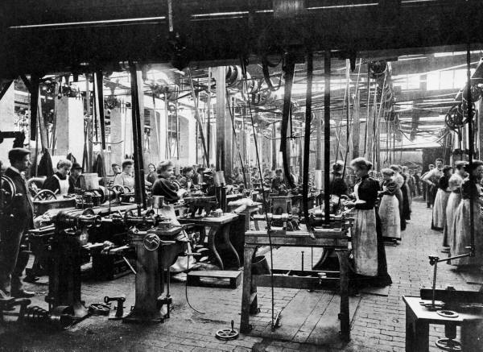
The Industrial Revolution
By 1900, the U.S. was the leading industrial nation in the world as millions left rural areas to work in the city
This happened due to an abundance of natural resources, a booming population, new inventions and the free enterprise system

Slide 33
Early Unions
The free enterprise system meant that businesses made their own rules
Without government interference, business owners could pay their workers what they wanted and make them work as long as they wanted
Industrialization during the late 1800s contributed to the development of organized labor because it created low-wage, low-skill jobs that made employees easy to replace.

Slide 34
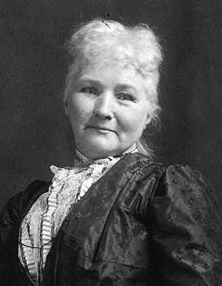
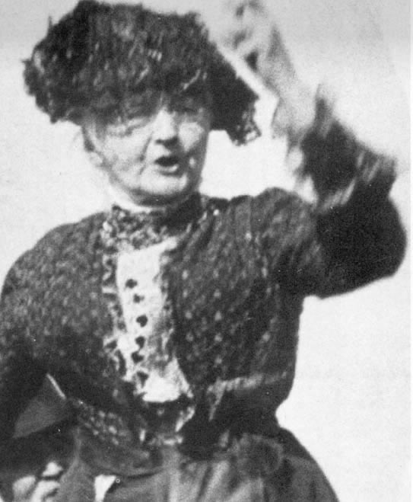
Mary Harris “Mother” Jones
Mother Jones was the nation’s most prominent woman union leader during the American Industrial Revolution
Jones became an organizer for the United Mine Workers
She traveled to numerous mining camps to see conditions miners had to endure. She gave fiery speeches for miners to unite to fight for better working conditions and better pay.

Slide 35
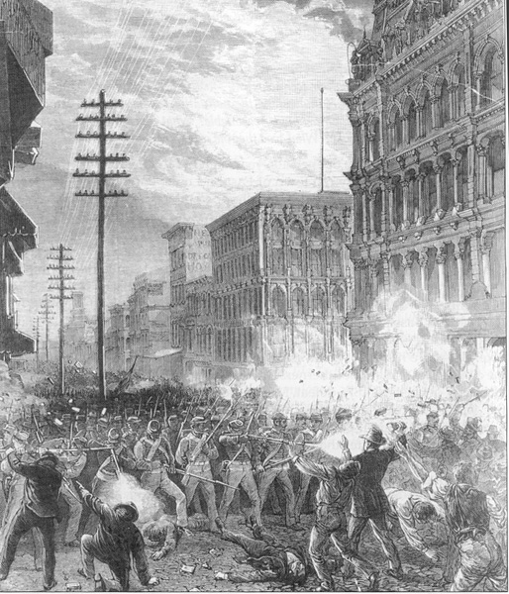
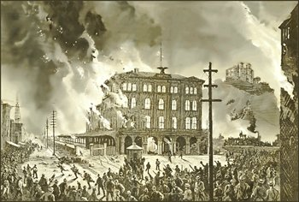
Great Railroad Strike of 1877
In 1877, a economic recession led to some railroads cutting wages, triggering the first nationwide labor strike. It became known as the Great Railroad Strike of 1877.
Some workers turned violent and numerous states had to call out their state militias to stop the violence.

Slide 36
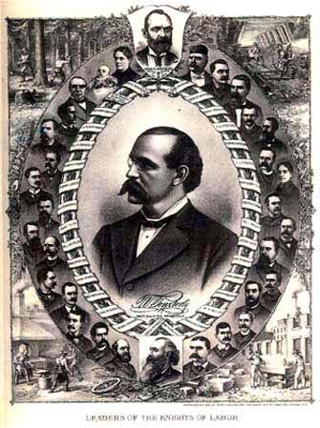
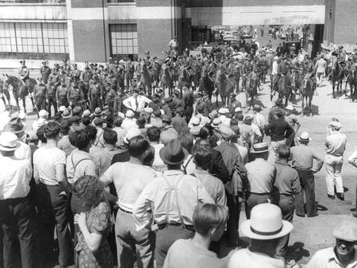
Knights of Labor
In response to the Great Railroad Strike of 1877, labor organizers formed the first nationwide industrial union – the Knights of Labor.
The Knights called for an eight-hour workday, supported the use of arbitration AND began to organize strikes.

Slide 37
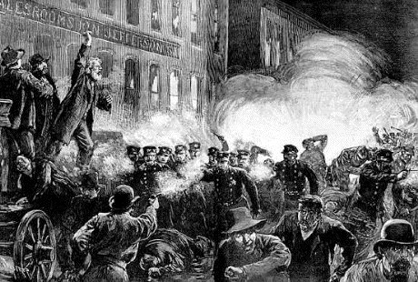
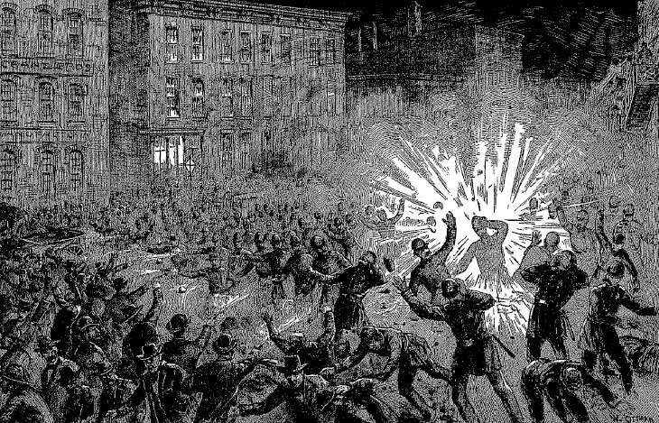
Haymarket Riot
The Haymarket Riot was the disturbance that took place on May 4, 1886, in Chicago, and began as a rally in support of striking workers.
A bomb was thrown during the rally, which started a riot. Eight men were convicted and four of them were executed. One of the men who was arrested was a member of the Knights of Labor.

Slide 38

Impact of Haymarket Riot
Union membership declined because more people saw unions as being Un-American

Slide 39


Pullman Strike
The Pullman Strike refers to a nationwide conflict between labor unions and railroads that occurred near Chicago in 1894.
Following the firing of union workers, Debs organized a strike that shut down the nation’s railroads and threatened the economy.

Slide 40


Women’s Trade Union League
In the early 1900s, women were paid less than men, and most unions did not include women.
As a result, in 1903 the Women’s Trade Union League was formed
This was the first union organized to address women’s labor issues.

Slide 41


Slide 42


